Slide 1
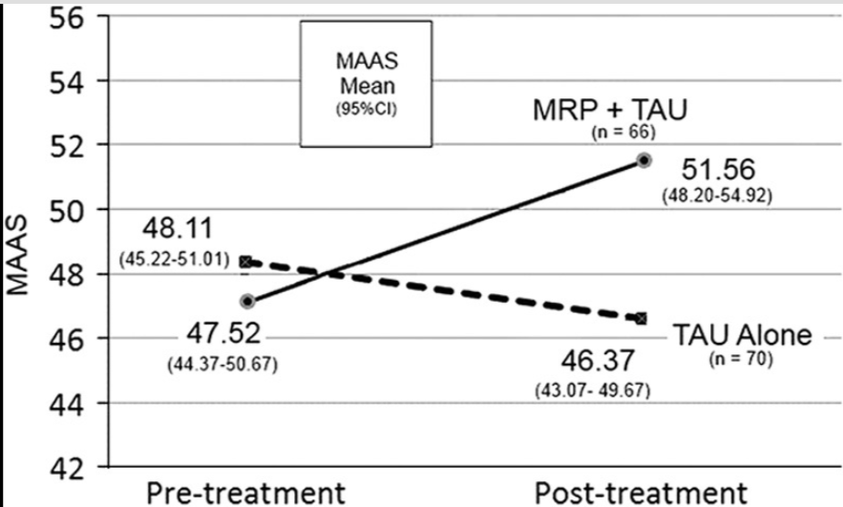
Mindful Attention Increases and Mediates Psychological Outcomes Following Mantram Repetition Practice in Veterans With Posttraumatic Stress Disorder
Name
Institution
Course
Purpose of the study
Purpose statement content
Study outcomes
Benefits of the Hierarchical Linear Modeling (HLM)
The study was aimed at investigating whether a mantram repetition program (MRP). As well as mindful attention mediation helped in reducing the severity of Post-Traumatic Stress Disorder (PTSD) and improving psychological wellbeing among veterans.
The study is aimed at evaluating the effects of the MRP and mindful attention mediated on mental health. This means a controlled trial would be required to evaluate the effectiveness of the intervention before and after one group is subjected to the interventions. A randomized control trial would hence be the best in this case West, et al, 2018).
The study identified that an increase in MRP and mediated practice helped in improving mindful attention. This supports the hypothesis of the study that MRP and mediated intervention bring more benefits compared to individuals who choose the treatment as usual plan(TAU).
It helps in creating easy modeling of data across multilevel interactions. It is also use it also helps in revealing the need for multilevel analysis of multilevel data (.Bormann, et al, 2017)
Data collection
Data was collected from 146 veterans who were to one or two conditions, a TAU as wells as TAU+MRP. Interviews were used in the assessment of PTSD. Hierarchical linear modeling was used in performing the regression analysis.
References
Research hypothesis
Bormann, J. E., Hurst, S., & Kelly, A. (2017). Responses to Mantram Repetition Program from Veterans with posttraumatic stress disorder: a qualitative analysis. Journal of Rehabilitation Research & Development, 50(6).
Bormann, Jill E. PhD, RN, FAAN*,†; Oman, Doug PhD‡; Walter, Kristen H. PhD§; Johnson, Brian D. PhD, MDiv, PMHNP-BC, DABPS† Mindful Attention Increases and Mediates Psychological Outcomes Following Mantram Repetition Practice in Veterans With Posttraumatic Stress Disorder, Medical Care: December 2014 - Volume 52 - Issue - p S13-S18
West, S. G., Duan, N., Pequegnat, W., Gaist, P., Des Jarlais, D. C., Holtgrave, D., ... & Mullen, P. D. (2018). Alternatives to the randomized controlled trial. American journal of public health, 98(8), 1359-1366.
The hypothesis of the study suggests that the MRP and mindful attention can help in improving the psychological outcomes of the veterans. This answers the question of the study whether any veterans benefit from these psychological interventions or with treatment as usual (TAU).
Recommendations
Further research can be conducted to investigate the severity of PTSD which these interventions can help with.

